Slide 1
INTERCULTURAL CONFLICT STYLES: ACTIVITY + ROLE PLAY

Slide 2
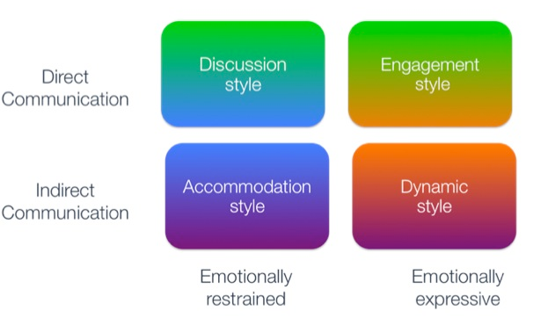
intercultural conflict styles
Hammer, M. (2005). Intercultural Conflict Style Inventory. ICS Inventory, LLC. Retrieved from https://icsinventory.com/
Notes:
Facilitator notes: Have participants discover their Intercultural Conflict Style by: 1) Taking the ICS Inventory (either in class or prior to class) if funding is available or 2) Describing the four conflict styles and asking participants to self-identify. Students can either refer to their report for their ICS scores or self-identify.

Slide 3
intercultural conflict styles: Fools rush in
Cross, V. (2010, November 7). Fools Rush In – Parents meet for the first time. [Video]. YouTube. https://www.youtube.com/watch?v=PpD072xGGJA
Notes:
Facilitator notes: Ask students to keep in mind the four conflict styles and work to identify when they see a style being demonstrated.

Slide 4
intercultural conflict styles: Fools rush in
Hammer, M. (2005). Intercultural Conflict Style Inventory. ICS Inventory, LLC. Retrieved from https://icsinventory.com/
Notes:
Facilitator notes: Stress that even for the same character, their conflict style can change over time as it gets heated. Consider asking – “What contextual factors can inform style shifts?” (Examples of contextual factors: Who you are talking to, what topic you’re discussing, where you are/physical environment, who can hear your conversation, emotions – fatigue, hunger, etc.)
For example, the men start at discussion and then go more toward engagement until it crosses a line.

Slide 5
intercultural conflict styles: Hum tum
[YRF]. (2012, February 4). Jo Tumne Kabhi Nahin Kaha | Scene | Hum Tum | Saif Ali Khan | Rani Mukerji. [Video] YouTube. https://www.youtube.com/watch?v=6dl9o3NohoM
Notes:
Facilitator notes: Ask students to keep in mind the four conflict styles and work to identify when they see a style being demonstrated.
Consider mentioning that in the U.S., it is difficult to find examples of a dynamic style and then show this clip. Emphasize that this clip is a very specific (and perhaps exaggerated for dramatic effect) example and does not characterize all of India in terms of conflict styles. Remind students to be careful about Bollywood stereotypes of India.

Slide 6
intercultural conflict styles: Hum tum
Hammer, M. (2005). Intercultural Conflict Style Inventory. ICS Inventory, LLC. Retrieved from https://icsinventory.com/

Slide 7
ICS patterns by country/region
Hammer, M. (2005). Intercultural Conflict Style Inventory. ICS Inventory, LLC. Retrieved from https://icsinventory.com/
Notes:
Facilitator notes: It will be important to emphasize that these regional/country patterns do not always apply (especially within co-cultures). Emphasize the regions of the world that are not represented by this graphic and consider how you might bolster the discussion with additional research.

Slide 8
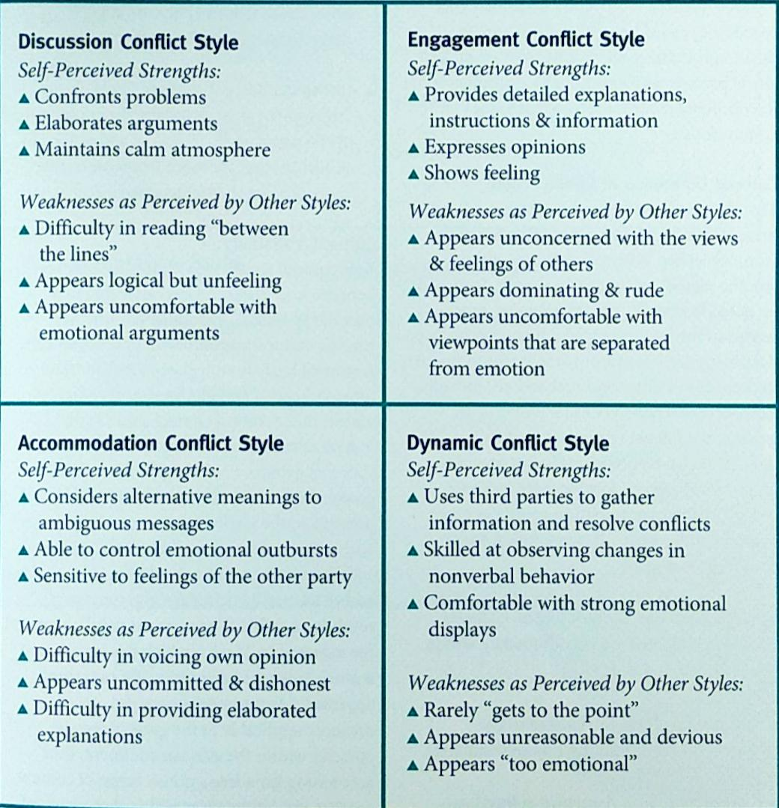
Ics: strengths and weaknesses
Hammer, M. (2005). Intercultural Conflict Style Inventory. ICS Inventory, LLC. Retrieved from https://icsinventory.com/
Notes:
Facilitator notes: This graphic demonstrates insider/outsider view descriptions. This can facilitate a great discussion showing our prejudice, normalizing the fact that when we work with people across conflict styles, our tendency can be to think their conflict styles aren’t correct, they’re trying to be mean, they’re not interested in engaging with us, etc. This graphic also places “good” and “bad” in subjective territory and can help students suspend judgment and practice curiosity and openness.
To draw out further discussion, encourage students to jigsaw (divide into 4 groups and each talk through insider/outsider views) – there is a lot to unpack as a whole and/or small group. You can divide students into groups representing different conflict styles or groups representing the same conflict style to discuss strengths and weaknesses.

Slide 9
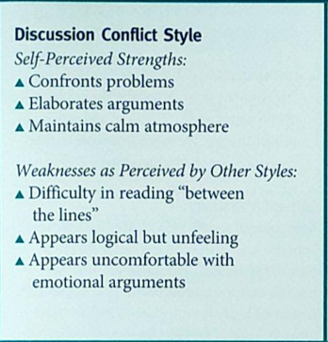
Ics: strengths and weaknesses
Hammer, M. (2005). Intercultural Conflict Style Inventory. ICS Inventory, LLC. Retrieved from https://icsinventory.com/
Notes:
Facilitator notes: These next four individual conflict style slides allows you to debrief the students’ discussions and dive into each quadrant in depth.

Slide 10
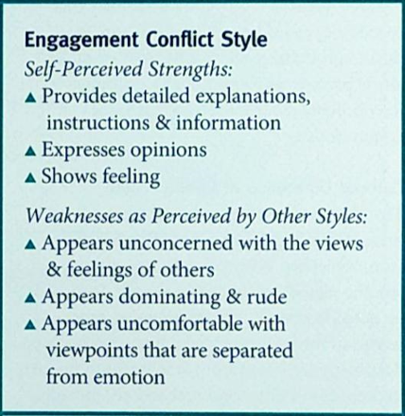
Ics: strengths and weaknesses
Hammer, M. (2005). Intercultural Conflict Style Inventory. ICS Inventory, LLC. Retrieved from https://icsinventory.com/

Slide 11
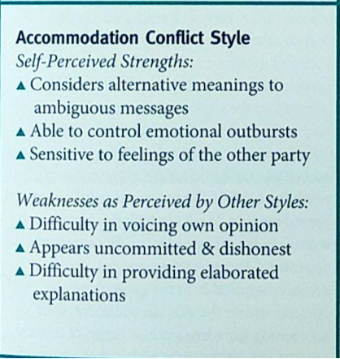
Ics: strengths and weaknesses
Hammer, M. (2005). Intercultural Conflict Style Inventory. ICS Inventory, LLC. Retrieved from https://icsinventory.com/

Slide 12
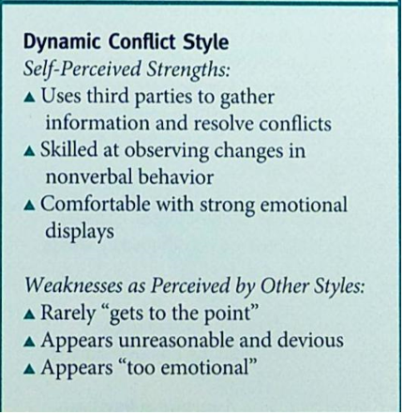
Ics: strengths and weaknesses
Hammer, M. (2005). Intercultural Conflict Style Inventory. ICS Inventory, LLC. Retrieved from https://icsinventory.com/

Slide 13
Ics model
DIRECT
INDIRECT
EMOTIONAL RESTRAINT
EMOTIONAL EXPRESSIVENESS
Notes:
Facilitator notes: Hand out sticky notes to students and ask them to “place themselves” (do not ask them to write their name – a blank sticky note works well for a simple visualization) on the chart on the board so the entire group can see the distribution of Intercultural Conflict Styles. This can be based on their ICS inventory score or a self-reported score.
Emphasize that no one quadrant is better or more effective than the others. People can communicate and resolve conflicts in the same quadrant, but problems arise when you have people communicating from different perspectives without self and other awareness that lets them navigate those differences.
The diagonal quadrants have the potential to be the most problematic because they cross more than one axis—the diagonals have two cultural values to navigate rather than one cultural difference.
It’s important to point out that it’s not really four categories, but it is two spectra. It does matter how comfortable an individual is with crossing over a line if they fall close to any of the lines.

Slide 14
discussion
How do you view conflict? Do you view it as destructive, as an opportunity, etc.? Why might someone have a differing view than you do of conflict? How does this impact how you evaluate whether a conflict was successful or not?
Can you think of a time when you were in a conflict with individuals from the other three quadrants? How did it make you feel? What happened?
How do you feel about other conflict styles?

Slide 15
discussion
When/with whom does your style vary the most? Do you ever find yourself moving into different styles depending on context/audience (e.g., with family, friends, at work, etc.).
How comfortable are you adapting to other styles? Which style is the most difficult for you to perform?
How might your conflict style impact communication in a personal or professional context?
How can you use the Intercultural Conflict Model to better understand others and come away from a conflict successfully?

Slide 16
Role play activity
Pair up and debate the topic using your typical conflict style. Argue for what you personally believe.
Then debate the topic, continuing to argue for your personal position, using:
Partner 1: Dynamic Partner 2: Discussion
Partner 1: Accommodation Partner 2: Engagement
As time allows, decide as a pair on different combinations where you share or differ in your conflict styles.
Hammer, M. (2005). Intercultural Conflict Style Inventory. ICS Inventory, LLC. Retrieved from https://icsinventory.com/
Notes:
Facilitator notes: Engage in a discussion with the class to identify a topic that partner pairs will debate. You will need to choose something students truly care about (you can either assign this or identify a topic as a class). Examples: immigration, best forms of exercise, most entertaining sports or film/book/music genres…Be aware of the dynamic of your classroom and choose a topic accordingly – for example, can your students handle a more charged topic, or might it be better to remain in less controversial territory?
Keep in mind that sometimes students shift into caricatures—this may be a good time to discuss stereotypes – was it overplayed, does your partner have any advice for you about how to do it better?

Slide 17
discussion
Was there anything about this experience that made you uncomfortable? What was the most challenging aspect?
How would you describe the dynamics that played out in your role play? What happened as a result of this difference? How did the role play conclude?
What aspects of your personal conflict style can be helpful and what aspects might be more challenging for others to interact with?

Slide 18
discussion
Did this activity bring about any realizations you had never considered before?
What skills will you take away from this that you might apply to a situation where someone has a different style from you?
How might you handle conflict if you and your boss or you and your significant other have a different style?
What do you still need to practice to be able to adjust fluidly across different styles?

